Slide 1

“Underwater Surface Target detection using Sound Navigation and Ranging to identify Mines with Machine Learning Prediction”
S.N.Arts, D.J.M. Commerce and B.N.S Science Collage, Sangamner
Academic Year - 2021-2022
Department of MATHEMATICS
Class:-T.Y.B.Sc
Presented by:
ANIKET DEEPAK TALEKAR
ROHIT DASHARATH DHARADE
A Project Review Presentation on

Slide 2
Content
Introduction
Problem Definition
Expected Outcome
Literature Survey
Class Diagram
Install Dependencies
Importing Datasets
Data Pre-Processing
Algorithm
Training ML Datasets
Results after Training
Conclusion

Slide 3
Introduction
The discovery of rocks and minerals would have been very dicult
past the development of the SONAR technique, which relays on certain parameters to be able to detect the obstacle or the surface is a rock or a mine.
Machine learning has drawn the attention of maximum part of the technology related and based industries, by showing advancements in the predictive analytics.
The main aim is to emanate a capable prediction representative, united
by the machine learning algorithmic characteristics, which can figure out if the target of the sound wave is either a rock or a mine or any other organism or any kind of other body.
This attempt is a clear-cut case study which comes up
with a machine learning plan for the grading of rocks and minerals, executed on a huge, highly spatial and complex SONAR dataset.

Slide 4
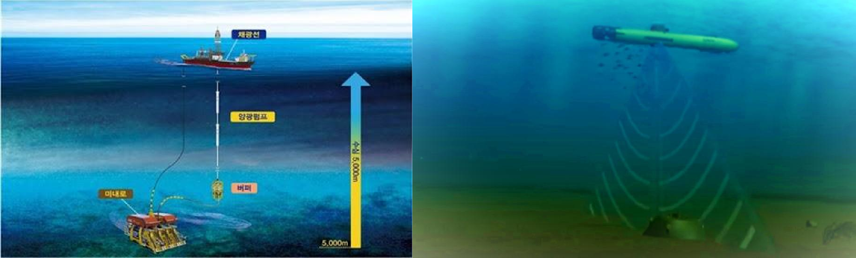
Problem Definition
Currently, Naval forces are relied upon the use of sidescan sonar imagery where the accuracy of the model is concerning. It is susceptible to false alarm in rigorous geographic locations.The purpose of this project is to investigate a system that can provide the naval forces with accurate data in shortest time possible.

Slide 5
Literature Review
Year | Author | Purpose | Technologies used | Accuracy
April-2020 | Aman Saraf Shantanu Mukesh Kumar Atharv Tiwari | Underwater Mines Detection using Neural Network | RCNN | mAP is 0.740 Mean average Precison
Feb- 2020 | Harvinder Singh and Nishtha Hooda | Prediction of Underwater Surface Target through SONAR: A Case Study of Machine Learning | Random forest | 83.17%

Slide 6
Nov - 2019 | S. N. Geethalakshmi, P. Subashini, S. Ramya | A Study on Detection and Classification of Underwater Mines using Neural Networks | Back propagation neural network (BPNN) classifier | 82%
Feb - 2018 | Prof. S.Veerabhadrh Dr.M.Purnacha ndra Rao | UNDERWATER MINES - PAST, PRESENT AND FUTURE | K - Means Clustering | 72.3%

Slide 7
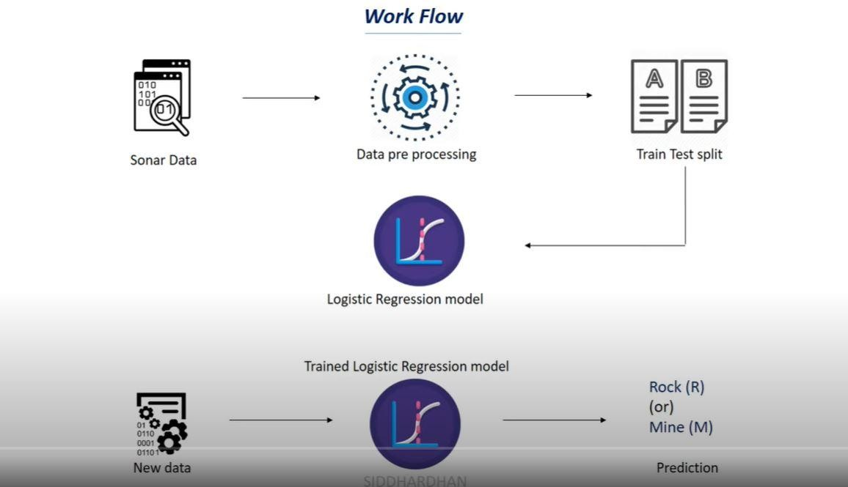

Slide 8
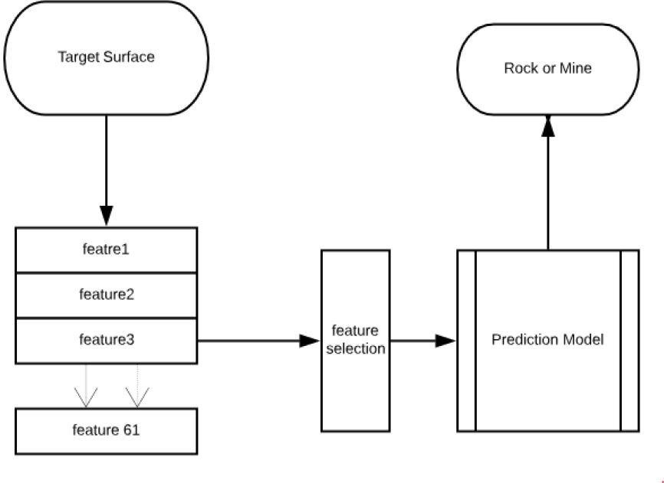
System Architecture diagram
Proposed Prediction Framework

Slide 9

Acquring Dataset
Sonar_Dataset.csv
Source:
https://drive.google.com/file/d/1pQxtljlNVh0DHYg-Ye7dtpDTlFceHVfa/view

Slide 10
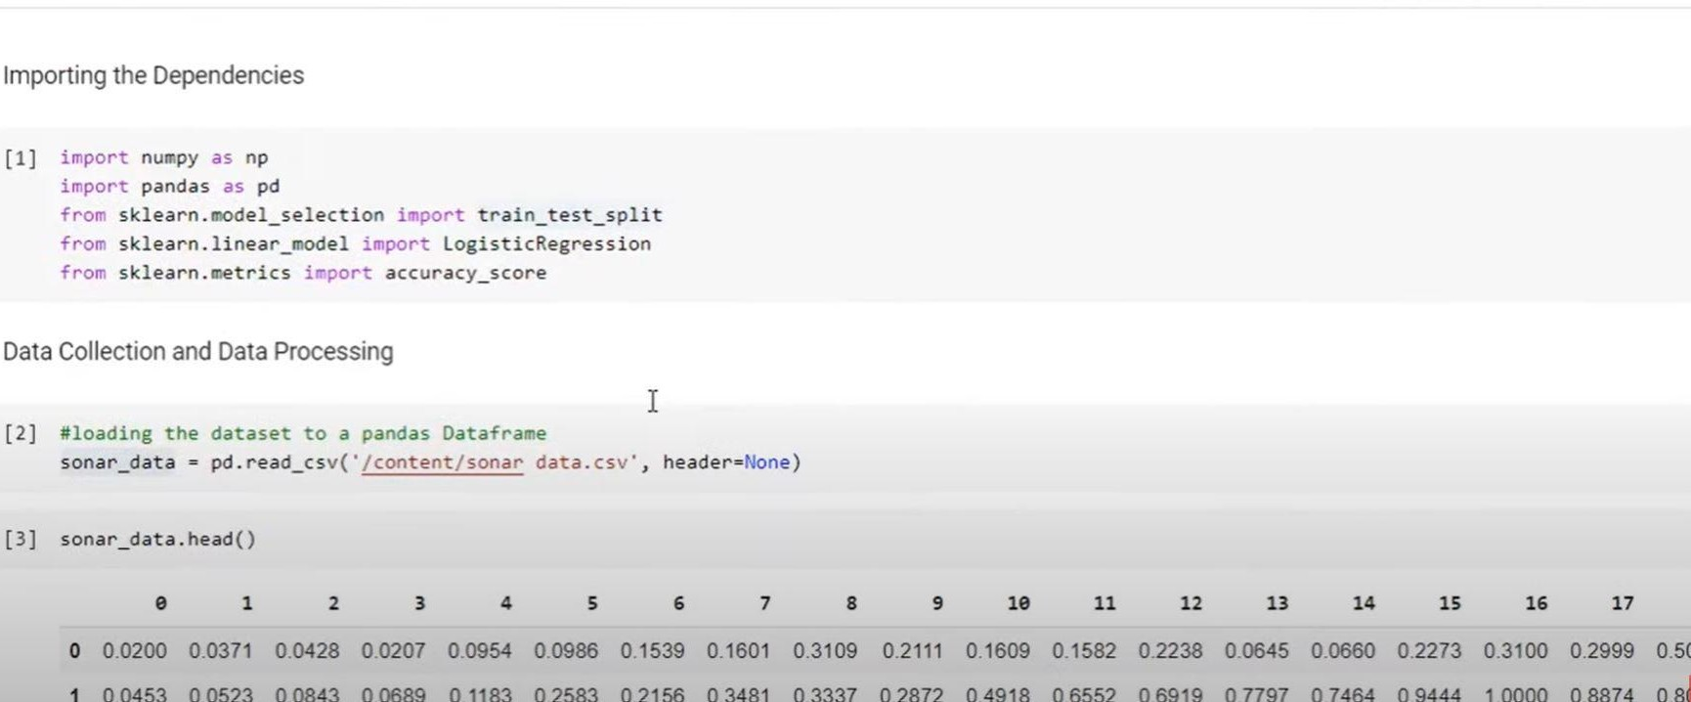

Slide 11
Install Dependencies
train_test_split
train_test_split numpy==1.19.5 matplotlib==3.4.1 scikit-learn==0.24.1 scikit-learn_metrics accuracy_score

Slide 12
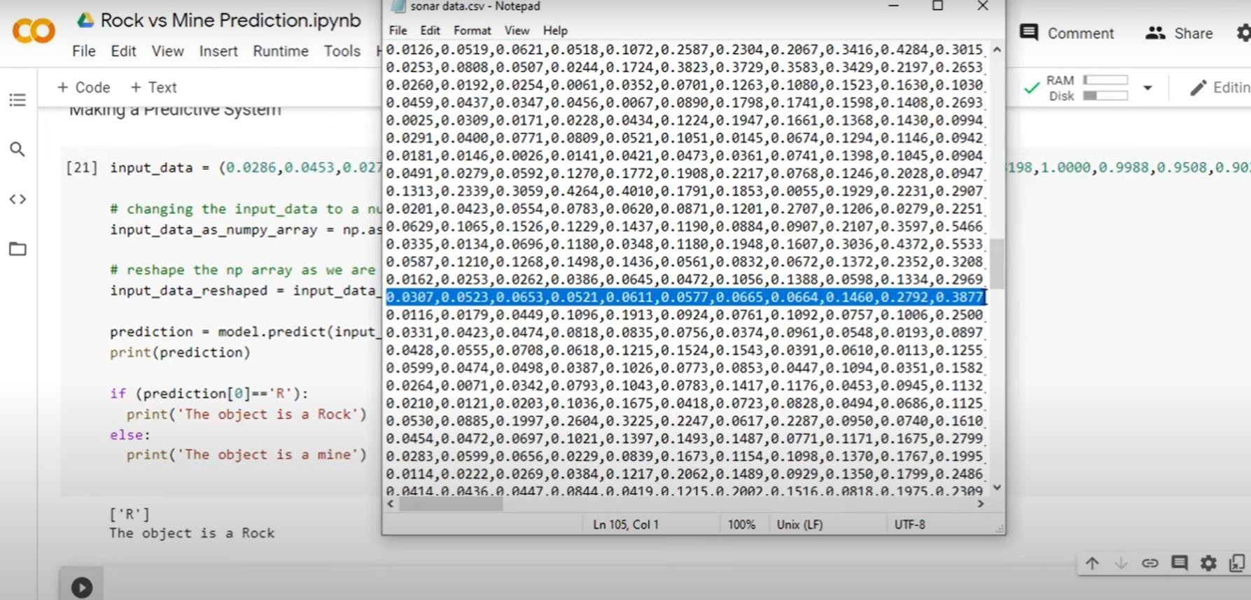
Data Pre-Processing
.

Slide 13
Expected Outcome
This prototype system is just a base of a simple implementation.This field offers a lot of scope for work and research in the coming future.
There is room for improving the overall system so that it can work and adapt in various underwater environment.

Slide 14
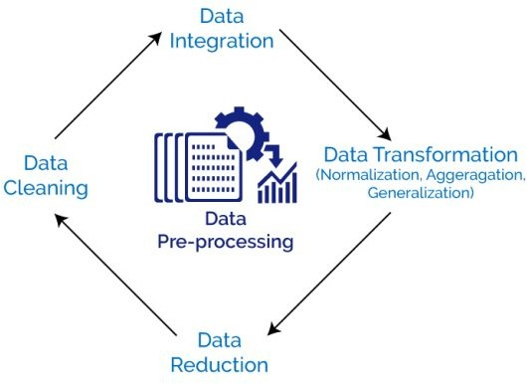
Data Collection and Data Processing
Data preprocessing is a step in our project for data analysis process that takes raw data and transforms it into a format that can be understood and analyzed by computers and machine learning.

Slide 15

Libraries used in the Project
1. NumPy:
NumPy is a Python library used for working with arrays. It also has functions for working in our project to analyse linear algebra, fourier transform, and matrices.

Slide 16

2. Pandas:
Pandas is a Python library used for working with our SONAR data set.It functions for analyzing, cleaning, exploring, and manipulating data.
Pandas allowed us to analyze big data and make conclusions based on statistical theories. It cleaned messy data sets, and made them readable and relevant.

Slide 17

3. Scikit-Learn:
Scikit-learn (Sklearn) is the most useful and robust library for our machine learning project in Python. It provided us a selection of efficient tools for machine learning and statistical modeling including classification, regression, via a consistent interface in Python.

Slide 18

4. Matplotlib :
The plot() function is used to draw points (markers)
By default, the plot() function draws a line from point to point.
The function takes parameters for specifying points in the diagram. Parameter 1 {ROCK} is an array containing the points on the x-axis. Parameter 2 { MINE} is an array containing the points on the y-axis.

Slide 19
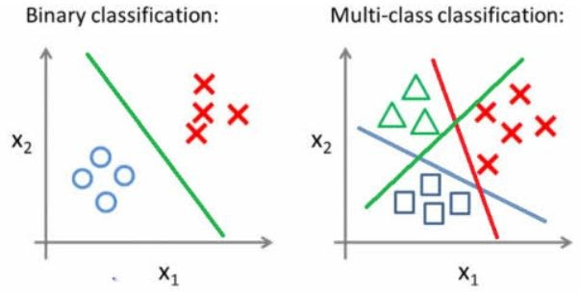
Binary Classification
It is a process or task of classification, in which a SONAR dataset is being classified into two classes. It’s basically a kind of prediction approach about where of two groups the thing belongs to.

Slide 20
Logistic Regression
Logistic regression predicts the output of a categorical dependent variable. Therefore the outcome in the project is a categorical or discrete value. It is either Yes or No, 0 or 1, true or False, etc. but instead of giving the exact value as 0 and 1, it gives the probabilistic values which lie between 0 and 1 as Rock or Mine Respectively.

Slide 21
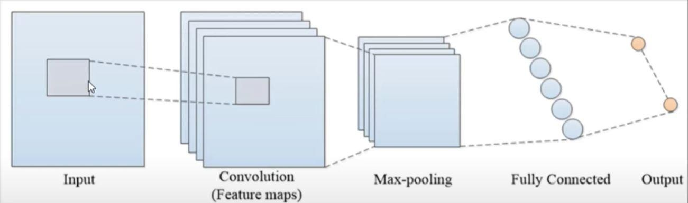
Training ML Model
A training model is a dataset that is used to train an ML algorithm. It consists of the sample output data and the corresponding sets of input data that have an influence on the output. The training model is used to run the input data through the algorithm to correlate the processed output against the sample output. The result from this correlation is used to modify the model.

Slide 22
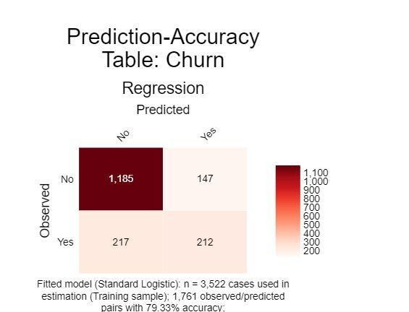
Accuracy Ratio
This project tests whether the accuracy of the model is likely to hold up when used in the "real world". The prediction accuracy of the model when applied to several observations that were not used when fitting the logistic regression is concluded to be found efficient and best to implement.
Source :
https://www.displayr.com/how-to-interpret-logistic-regression-outputs/

Slide 23
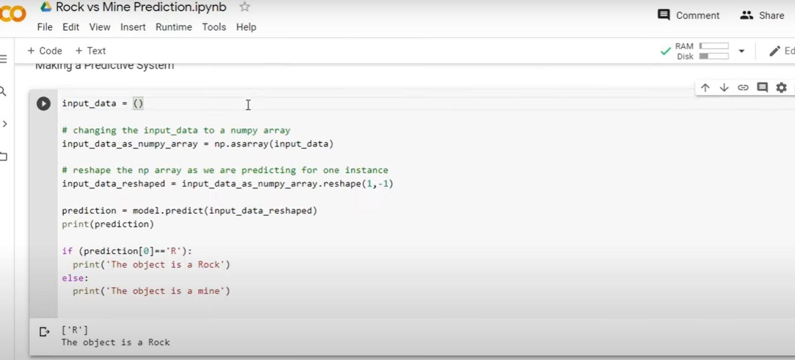
Results after Training Prediction Model

Slide 24
Conclusion
The main concern of Naval Defence to analyse in the field of machine learning and to form a scheduled computational machine for the categorizing the forecast of the objects, based on the attainable information.
The outcome of proposed framework helps to predict the triggered sound waves reflect back from what surface:
Rock or a Mine

Slide 25



